Slide 1
Feature Engineering / Feature Selection

Slide 2
Feature Engineering
For a model to become successful, the variables / parameters that are used to construct the model are critical. In their raw form, the variables may not be (usually are not) in a state where they can be used for modeling
Feature engineering is the process of transforming data from the raw state to a state where it becomes suitable for modeling.
It transforms the data columns into features that are better at representing a give situation in terms of clarity.
Quality of the feature in distinctly representing an entity impact the quality of the model in predicting the behavior of the entity
Exploratory Data Analytics (EDA) is the first step towards feature engineering as it is critical to assess the quality of the raw data, plan the transformations required

Slide 3
Exploratory data analytics (EDA)
Some of the key activities performed in EDA include –
Meaningful standardized names to the attributes
Meta information about the data. Describe the column level details such as what it is, how it was collected, units of measurement, frequency of measurement, possible range of values etc.
List and address the challenges that one will face using the data in its existing form. For e.g. missing values, outliers, data shift, sampling bias
Descriptive stats – spread(central values , skew, tails), mixup of gaussians
Data distribution across different target classes (if in classification domain)
Outlier analysis and strategy for imputations
Assessing the impact of the actions taken on the data (modified the distribution?

Slide 4
Exploratory data analytics (EDA)
Some of the key activities performed in EDA include –
Transform the raw data into useful attributes by generating derived attributes from existing attributes if the derived attributes are likely to be better than original attributes in information content
Transform the data attributes using valid mathematical transformations such as log transformation of the distribution, if the transformed data is likely to help create simpler model without loosing information

Slide 5
Feature Engineering on Numeric data
Integers and floats are the most common data types that are directly used in building models. Instead, transforming them before modelling may yield better results!
Feature engineering on numerical columns may take the form of-
scaling the data if using algorithms that involve similarity measurements based on distance calculations
Transforming the distributions using mathematical techniques such as exponential distribution to almost normal using log functions
Binning the numeric data followed by binarization for e.g. using one-hot coding
Binning can help make linear models powerful when the data distribution on predictors is spread out though it has a trend
Interaction & Polynomial features – Another way to enrich feature representation, especially in linear models is using interaction features , polynomial features
In the binning example the linear model creates constant value in each bin (intercept), however, we can also make it learn the slope by including the original feature

Slide 6
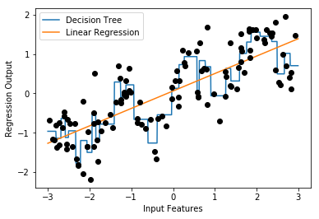

Feature Engineering on Numeric data
Linea Model and Binning, OneHotCoding
A comparison of decision tree and a simple linear model on the given data
Decision tree is more flexible and does better than linear model
Suppose we have to build linear model only, we can use binning to enrich the attributes
Note: This example uses a package mglearn which is available on Git (https://github.com/amueller/mglearn) and is used with a book “Introduction to Machine Learning with Python”

Slide 7
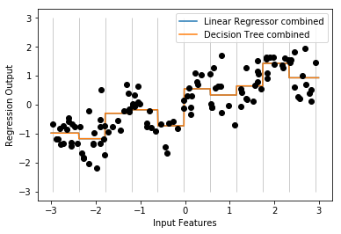
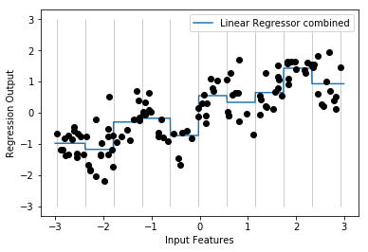

Feature Engineering on Numeric data
Linear Model and Binning, OneHotCoding
After binning, the decision tree boundaries and linear regression boundaries are exactly same. They are overlapping.
For each bin, both models are predicting a single value as output
Comparing the linear models before binning and after binning, we can see that the linear model has become more flexible.
Note: This example uses a package mglearn which is available on Git (https://github.com/amueller/mglearn) and is used with a book “Introduction to Machine Learning with Python”

Slide 8
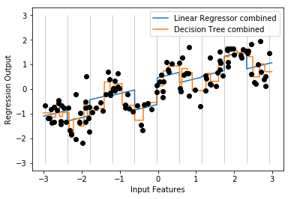
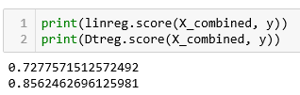
Feature Engineering on Numeric data
Linear Model with binning and original value combined
The input data is not only the bins but also include the original X column
Presence of the original column with each bin, introduces a slope and offset for each bin. For e.g. [-0.75275929, 0. , 0. , 0. , 1. , 0. , 0. , 0. , 0. , 0. , 0. ]
Linear model performance as marginally gone up
Decision tree, given it’s non-parametric property, has become more complex and hence accurate
Note: This example uses a package mglearn which is available on Git (https://github.com/amueller/mglearn) and is used with a book “Introduction to Machine Learning with Python”

Slide 9
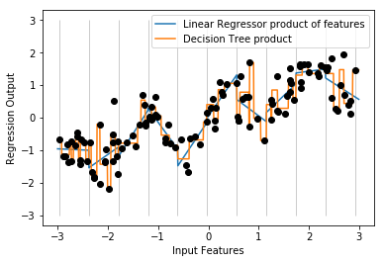

Feature Engineering on Numeric data
Linear Model with binning and interaction features
Create an interaction feature by using simple multiple operation. For e.g. X_product = np.hstack([X_binned, X_binned * X])
The input data now has onehotcoded bins with one bin carrying the original value for e.g. [ 0. , 0. , 0. , 1. , 0. , 0. , 0. , 0. , 0. , 0. , -0. , -0. , -0. , -0.75275929, -0. , -0. , -0. , -0. , -0. , -0. ]
Note: This example uses a package mglearn which is available on Git (https://github.com/amueller/mglearn) and is used with a book “Introduction to Machine Learning with Python”

Slide 10
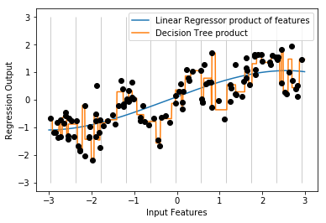

Feature Engineering on Numeric data
Linear Model with binning and polynomial features
Create polynomial features from the original column using the function poly = PolynomialFeatures(degree=3, include_bias=False)
In this example degree is 3 which means we will have x, x^2, x^3 as our features
As expected, decision tree overfits while the linear model seems underfit at this degree
Note: This example uses a package mglearn which is available on Git (https://github.com/amueller/mglearn) and is used with a book “Introduction to Machine Learning with Python”

Slide 11
Feature Engineering on Numeric data
Linear Model with binning and polynomial features
Create polynomial features from the original column using the function poly = PolynomialFeatures(degree=3, include_bias=False)
In this example degree is 3 which means we will have x, x^2, x^3 as our features
As expected, decision tree overfits while the linear model seems underfit at this degree
Note: This example uses a package mglearn which is available on Git (https://github.com/amueller/mglearn) and is used with a book “Introduction to Machine Learning with Python”

Slide 12
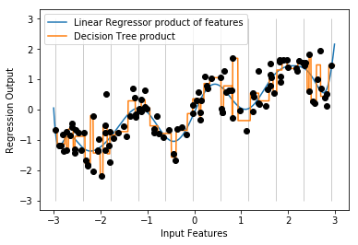

Feature Engineering on Numeric data
Linear Model with binning and polynomial features
Create polynomial features from the original column using the function poly = PolynomialFeatures(degree=15, include_bias=False)
The linear regression line is now looking a better fit
Polynomial features have a problem with extreme values or in regions where data is scant.
SVM /SVR may be a natural choice as SVR generates features using kernels automatically
Note: This example uses a package mglearn which is available on Git (https://github.com/amueller/mglearn) and is used with a book “Introduction to Machine Learning with Python”

Slide 13
Feature Selection
Suppose you have a learning algorithm LA and a set of input attributes { X1 , X2 .. Xp }
You expect that LA will only find some subset of the attributes useful.
Question: How can we use cross-validation to find a useful subset?
Some ideas:
Forward selection
Backward elimination
Mixed selection

Slide 14
Forward Selection
Begin with null model - a model that contains an intercept but no predictors
Then fit p simple linear regressions and add to the null model the variable that results in the lowest RSS(or highest R^2)
Then add to that model the variable that results in the lowest RSS(or highest R^2) for the new two-variable model
Continue this approach until some stopping rule is satisfied

Slide 15
Backward Elimination
Start with all variables in the model
Remove a variable from the above model and check the increment in RSS (or decrement in R^2) and remove the variable which has least influence, i.e., the variable that is least significant
The new (p-1) variable model is fit and the variable with the least significance is removed.
Continue this procedure until a stopping rule is reached

